Slide 1

Puberty
Year 7 Health – 2024
Lesson 10

Slide 2
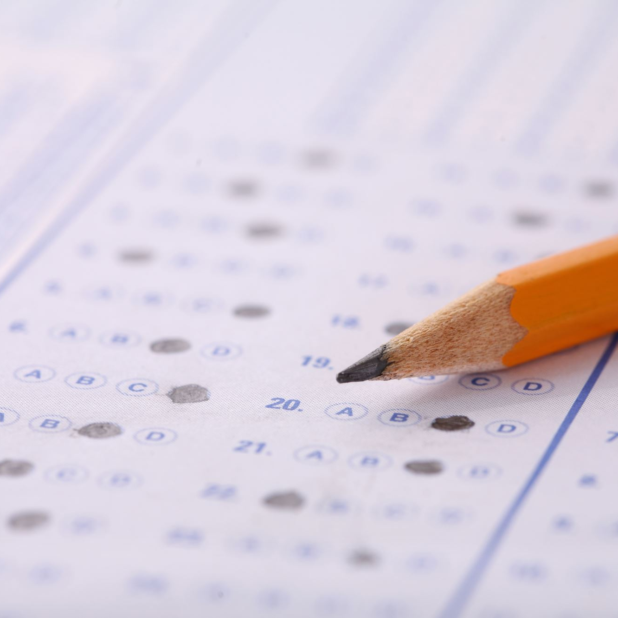
TOPIC TEST
Separate all desks.
You need a pen.
No talking or cheating.
  May result in a loss of marks/score of 0
If you finish early, raise your hand and your teacher will collect your test paper.
Notes:
Early finisher activity included in the lesson 10 folder.

